Slide 1
Strengthening Mechanisms :
Solid Solution Strengthening
Strain Hardening
Precipitation Hardening
Grain Boundary Strengthening

Slide 2
Cutting precipitates:
When too small - dislocations can cut them:

Slide 3
Bowing:
Orowan looping
L
dislocations bow past
precipitates
precipitates
slow dislocations
L = inter precipitate distance
τ_{y} = Gb / L

Slide 5
Precipitation strengthening:
cutting
bowing
50
40
30
precipitates get too big, i.e. spacing (L) too large.
no
precipitates
σ_{y} (ksi)
precipitates
form and grow
τ_{y} = Gb / L
Heat Treating Time

Slide 6
Strengthening Mechanisms :
Solid Solution Strengthening
Strain Hardening
Precipitation Hardening
Grain Boundary Strengthening

Slide 7
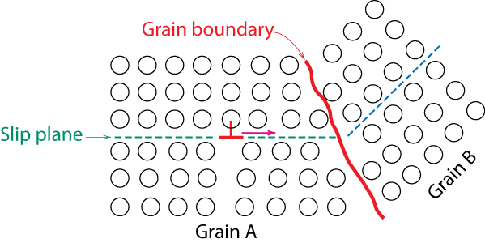
Strengthening through Grain Size Reduction
Grain boundaries are barriers to slip.
Barrier "strength” increases with increasing angle of misorientation
For high-angle grain boundaries, dislocations cannot traverse across grain boundaries
A stress concentration ahead of a slip plane in one grain may activate sources of new dislocations in an adjacent grain.

Slide 8
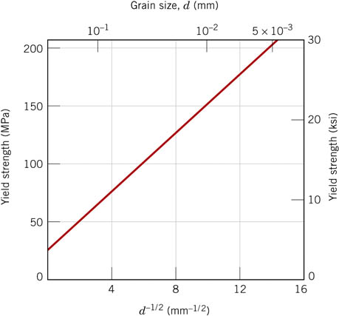
Strengthening through Grain Size Reduction
• Smaller grain size: more barriers to slip
a greater total grain boundary area to impede dislocation motion
Hall-Petch Equation:
Not valid for both very large or very fine grains

Slide 9
How is grain size regulated?
Grain size may be regulated
by the rate of solidification from the liquid phase, and also
by Cold Work followed by an appropriate heat treatment

Slide 10
Effects of cold work
Cold Work →
A change in grain shape and grain orientation
Strain hardening (increase in dislocation density)
Electrical conductivity and corrosion resistance may be modified

Slide 11
Restoration of pre cold-worked state
Properties and structures may revert back to the precold-worked states by appropriate heat treatment (sometimes termed an annealing treatment).
Such restoration results from two different processes that occur at elevated temperatures:
Recovery and
Recrystallization,
followed by grain growth.

Slide 12
Recovery
During recovery, Reduction in some of the stored internal strain energy through
Some reduction in the number of dislocations (dislocation annihilation)
Dislocation configurations are produced having low strain energies.
by virtue of dislocation motion (in the absence of an externally applied stress), as a result of enhanced atomic diffusion at the elevated temperature.
Driving force: Stored internal energy

Slide 13
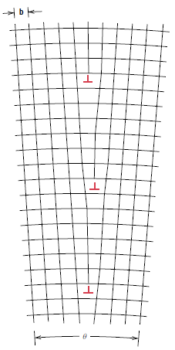
Low energy configuration of dislocations

Slide 14
Recrystallization
Recrystallization is the formation of a new set of strain-free and equiaxed grains that have low dislocation densities
Even after recovery is complete, the grains still have stored strain energy.
Driving force: Stored internal energy
The new grains form as very small nuclei and grow until they completely replace the parent deformed material.

Slide 15
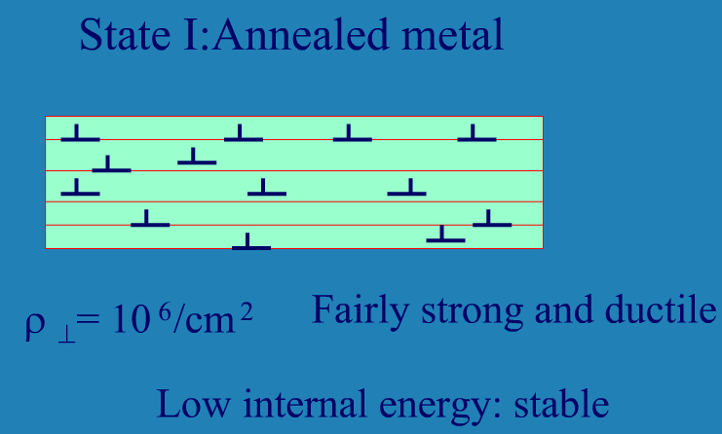
Starting Material

Slide 16
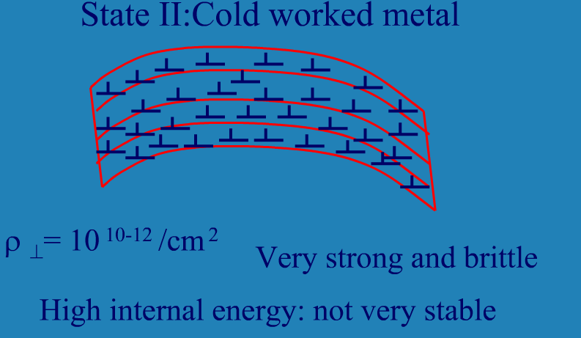
Cold Worked

Slide 17
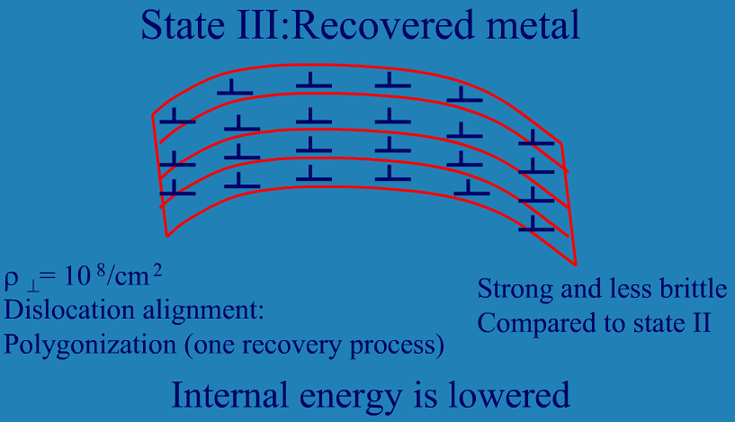
Heated at ~ 0.5 T_{m}

Slide 18
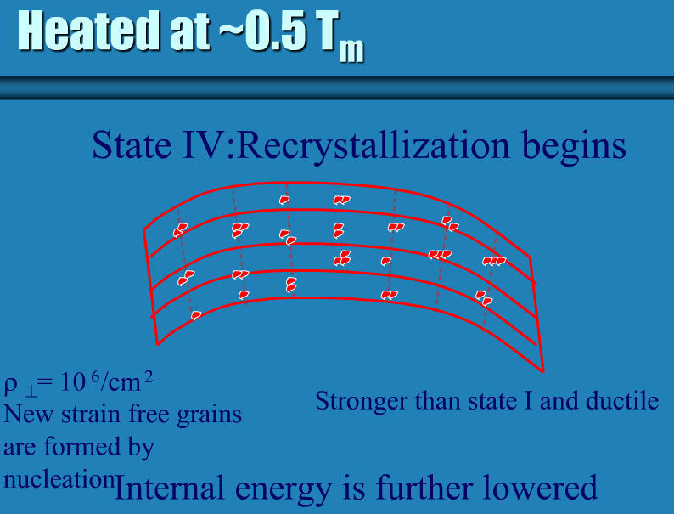
Recrystallization

Slide 19
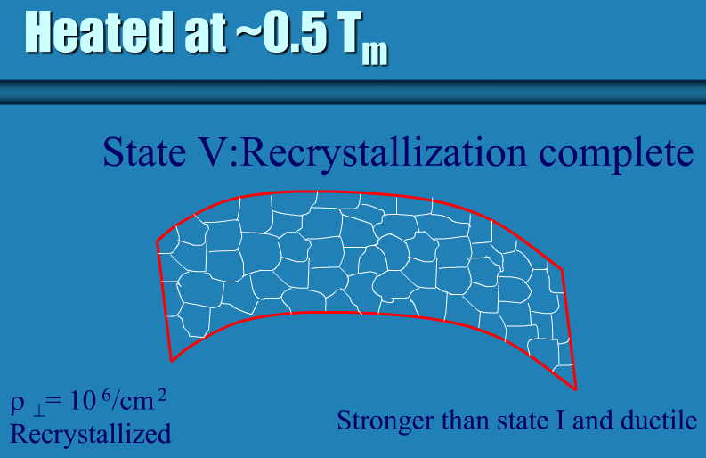
Recrystallization

Slide 20
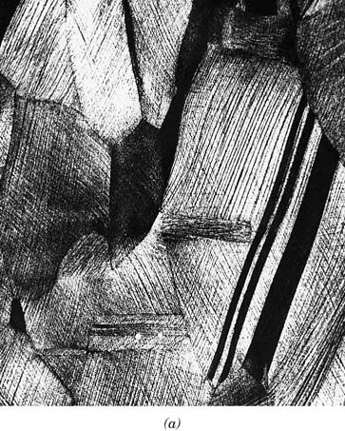
f21a_07_pg195
Several Stages of Recrystallization and grain growth of brass
Cold worked Structure
Notes:
f21a_07_pg195.jpg

Slide 21
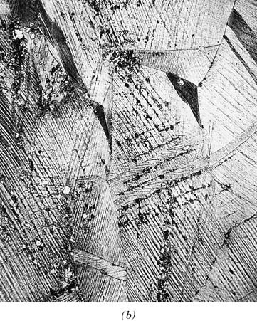
f21b_07_pg195
Several Stages of Recrystallization and grain growth of brass
Initial stage of recrystallization
Degree of recrystallization increases with time
Notes:
f21b_07_pg195.jpg

Slide 22
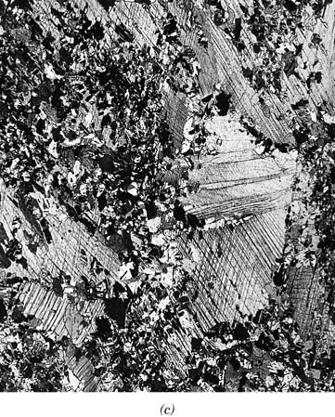
f21c_07_pg196
Several Stages of Recrystallization and grain growth of brass
Partial replacement of cold worked grains by recrystallized ones
Degree of recrystallization increases with time
Notes:
f21c_07_pg196.jpg

Slide 23
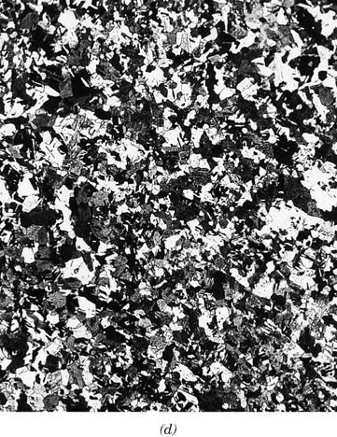
f21d_07_pg197
Several Stages of Recrystallization and grain growth of brass
Complete recrystallization
Degree of recrystallization increases with time
Notes:
f21d_07_pg197.jpg

Slide 24
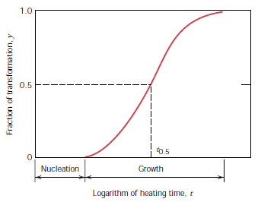
Kinetics of recrystallization
Extent of Recrystallization depends on both time and temperature.
The degree (or fraction) of recrystallization increases with time
At constant temperature
Avrami Equation

Slide 25
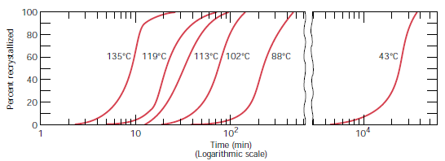
Kinetics of recrystallization: Example for pure Copper
At different temperatures

Slide 26
Recrystallization temperature
T_{R} = recrystallization temperature = The temperature at which recrystallization just reaches completion in 1 h.
Typically, it is between 0.3 T_{m} and 0.5 T_{m}
Depends on several factors:
The amount of prior cold work
T_{R} is lowered as %CW increases
The purity of the alloy.
Recrystallization proceeds more rapidly in pure metals than in alloys. Thus, alloying raises the recrystallization temperature, sometimes quite substantially.
For pure metals, the recrystallization temperature is normally 0.3Tm
For some commercial alloys it may run as high as 0.7Tm.

Slide 27
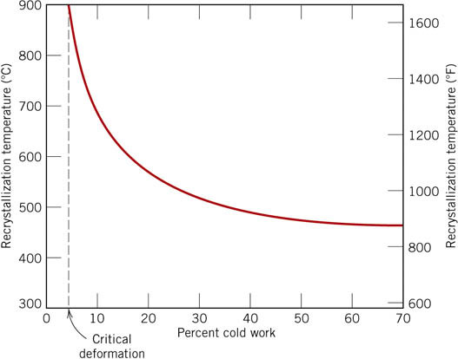
f23_07_pg198
The recrystallization temperature is lowered, and approaches a constant or limiting value at high deformations
There exists some critical degree of cold work below which recrystallization cannot be made to occur; normally, this is between 2 and 20% cold work.
Notes:
f23_07_pg198.jpg

Slide 28
Grain Growth
After recrystallization is complete, the strain-free grains will continue to grow if the metal specimen is left at the elevated temperature
Driving force: Grain boundary energy
An energy is associated with grain boundaries. As grains increase in size, the total boundary area decreases, yielding an attendant reduction in the total energy.
Grain growth occurs by the migration of grain boundaries.
Not all grains can enlarge, but large ones grow at the expense of small ones that shrink.
Thus, the average grain size increases with time.

Slide 29
f21d_07_pg197
Several Stages of Recrystallization and grain growth of brass
Complete recrystallization
Degree of recrystallization increases with time
Notes:
f21d_07_pg197.jpg

Slide 30
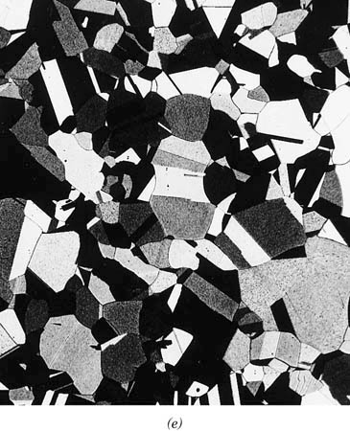
f21e_07_pg196
Grain growth of brass at 580 deg C
Grain growth at low temperature
Notes:
f21e_07_pg196.jpg

Slide 31
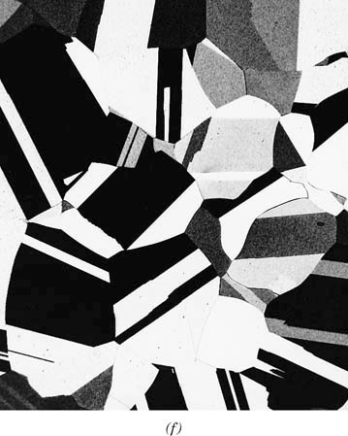
f21f_07_pg196
Grain growth of brass at 700 deg C
Further grain growth at higher temperature
Notes:
f21f_07_pg196.jpg

Slide 32
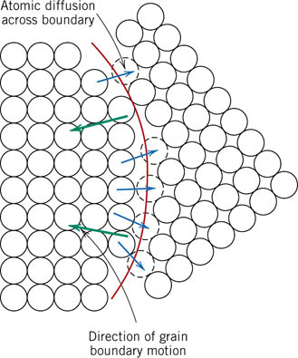
f24_07_pg200
Grain Growth
Boundary motion is just the short-range diffusion of atoms from one side of the boundary to the other.
The directions of boundary movement and atomic motion are opposite to each other
Notes:
f24_07_pg200.jpg

Slide 33

Grain Growth Equation
For many polycrystalline materials, the grain diameter d varies with time t according to the relationship
d₀ is the initial grain diameter at t =0,
K and n are time-independent constants
The value of n is generally equal to or greater than 2.

Slide 34
Characteristic differences between Recovery, Recrystallization, and Grain Growth
Recrystallization & Recovery:
Recrystallization: High angle grain boundaries migrate
Recovery: High angle grain boundaries do not migrate
Recrystallization and grain growth
Recrystallization: Driving force stored strain energy
Grain Growth: Driving force is the total grain boundary energy

Slide 35
Hot Working
Deforming at high enough temperature
Dynamic recrystallization occurs
Used for large deformation
Poor surface finish - oxidation

